Slide 1


Time series analysis and visualization in brief
May 2025
Achangwa Chiara, M.Sc., Ph.D.
ciaraacha@gmail.com
Department of Preventive Medicine,
The Catholic University of Korea, Seoul, Korea.

Slide 2
Lecture content
1. Overview of time series analysis
2. Time series models
3. Practice in R
Requirements
- A laptop
- R/RStudio installed
- Download the mock data and R code provided

Slide 3
1. Overview of Time Series Analysis
A Time Series is a collection of observations y made sequentially in time t, that is
a series of values collected over a period of time
Time series data can be collected
Every year
Every quarter
Every month
Every week
Everyday
Year | 2010 | 2011 | 2012 | 2013
Prevalence of HBV | 2.3 | 2.6 | 3.1 | 3.3
Quarter | Quarter 1 | Quarter 2 | Quarter 3 | Quarter 4
N° of Measles | 3.6 | 5.2 | 13.2 | 4.3
Month | Jan | Feb | Mar | Apr | May | Jun | Jul | Aug | Sep
N° of IFV cases | 120 | 123 | 133 | 125 | 130 | 132 | 132 | 132 | 133
Week | W1 | W2 | W3 | W4 | W5 | W6 | W7 | W8 | W9 | W10
N° of NTD cases | 520 | 523 | 733 | 465 | 450 | 451 | 554 | 185 | 253 | 158
Days | 1 | 2 | 3 | 4 | 5 | 6 | 7 | 8 | 9 | 10 | 11 | 12
N° of NTD cases | 120 | 123 | 133 | 125 | 130 | 132 | 132 | 132 | 133 | 125 | 128 | 128

Slide 4
A discrete time series is a collection of data with distinct values or categories, like counts of events, categorical statuses, etc, recorded at specific times.
A continuous time series is a collection of data, a continuous range of values, like temperature, height etc, at regular time intervals.
Week | Influenza_A Cases | Vaccination Coverage (%) | School Closure
1 | 15 | 12 | 0
2 | 22 | 15 | 0
Date | Anti_S IgG Level | Vaccination Status | Age Group | Infection Status
2025-05-01 | 95.3 | Vaccinated | 30–50 | Infection
2025-05-02 | 108.5 | Not vaccinated | 30–50 | Infection

Slide 5
Importance of time series
Understanding the past behavior of a dataset
Can forecast future trends/activities, hence can be used to plan future interventions
Evaluate current interventions
Facilitates comparison of periods/intervention

Slide 6
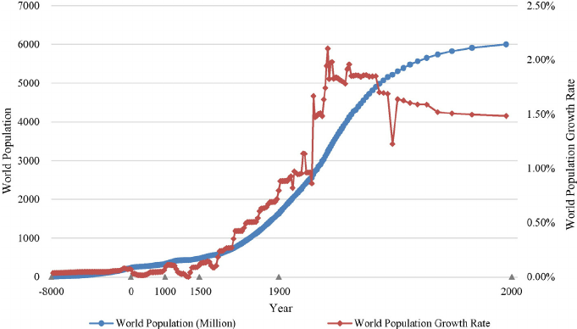
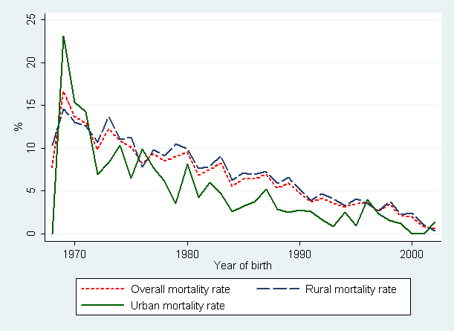
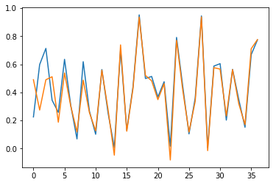
Components of a time series analysis
Upward pattern
Plotting a time series is an important early step in the analysis of time series data
Trends: the upward, downward, or no pattern observed
Why measure trends?
Past behavior
Estimation
Other components
Downward pattern
No pattern

Slide 7
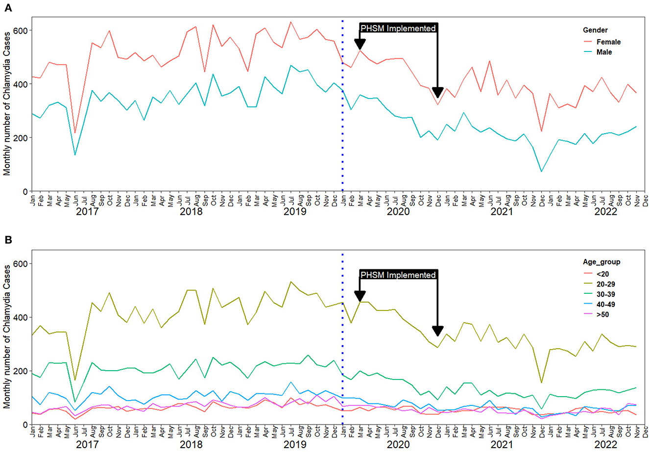
Achangwa et al., Frontiers in Public Health, 2023.

Slide 8
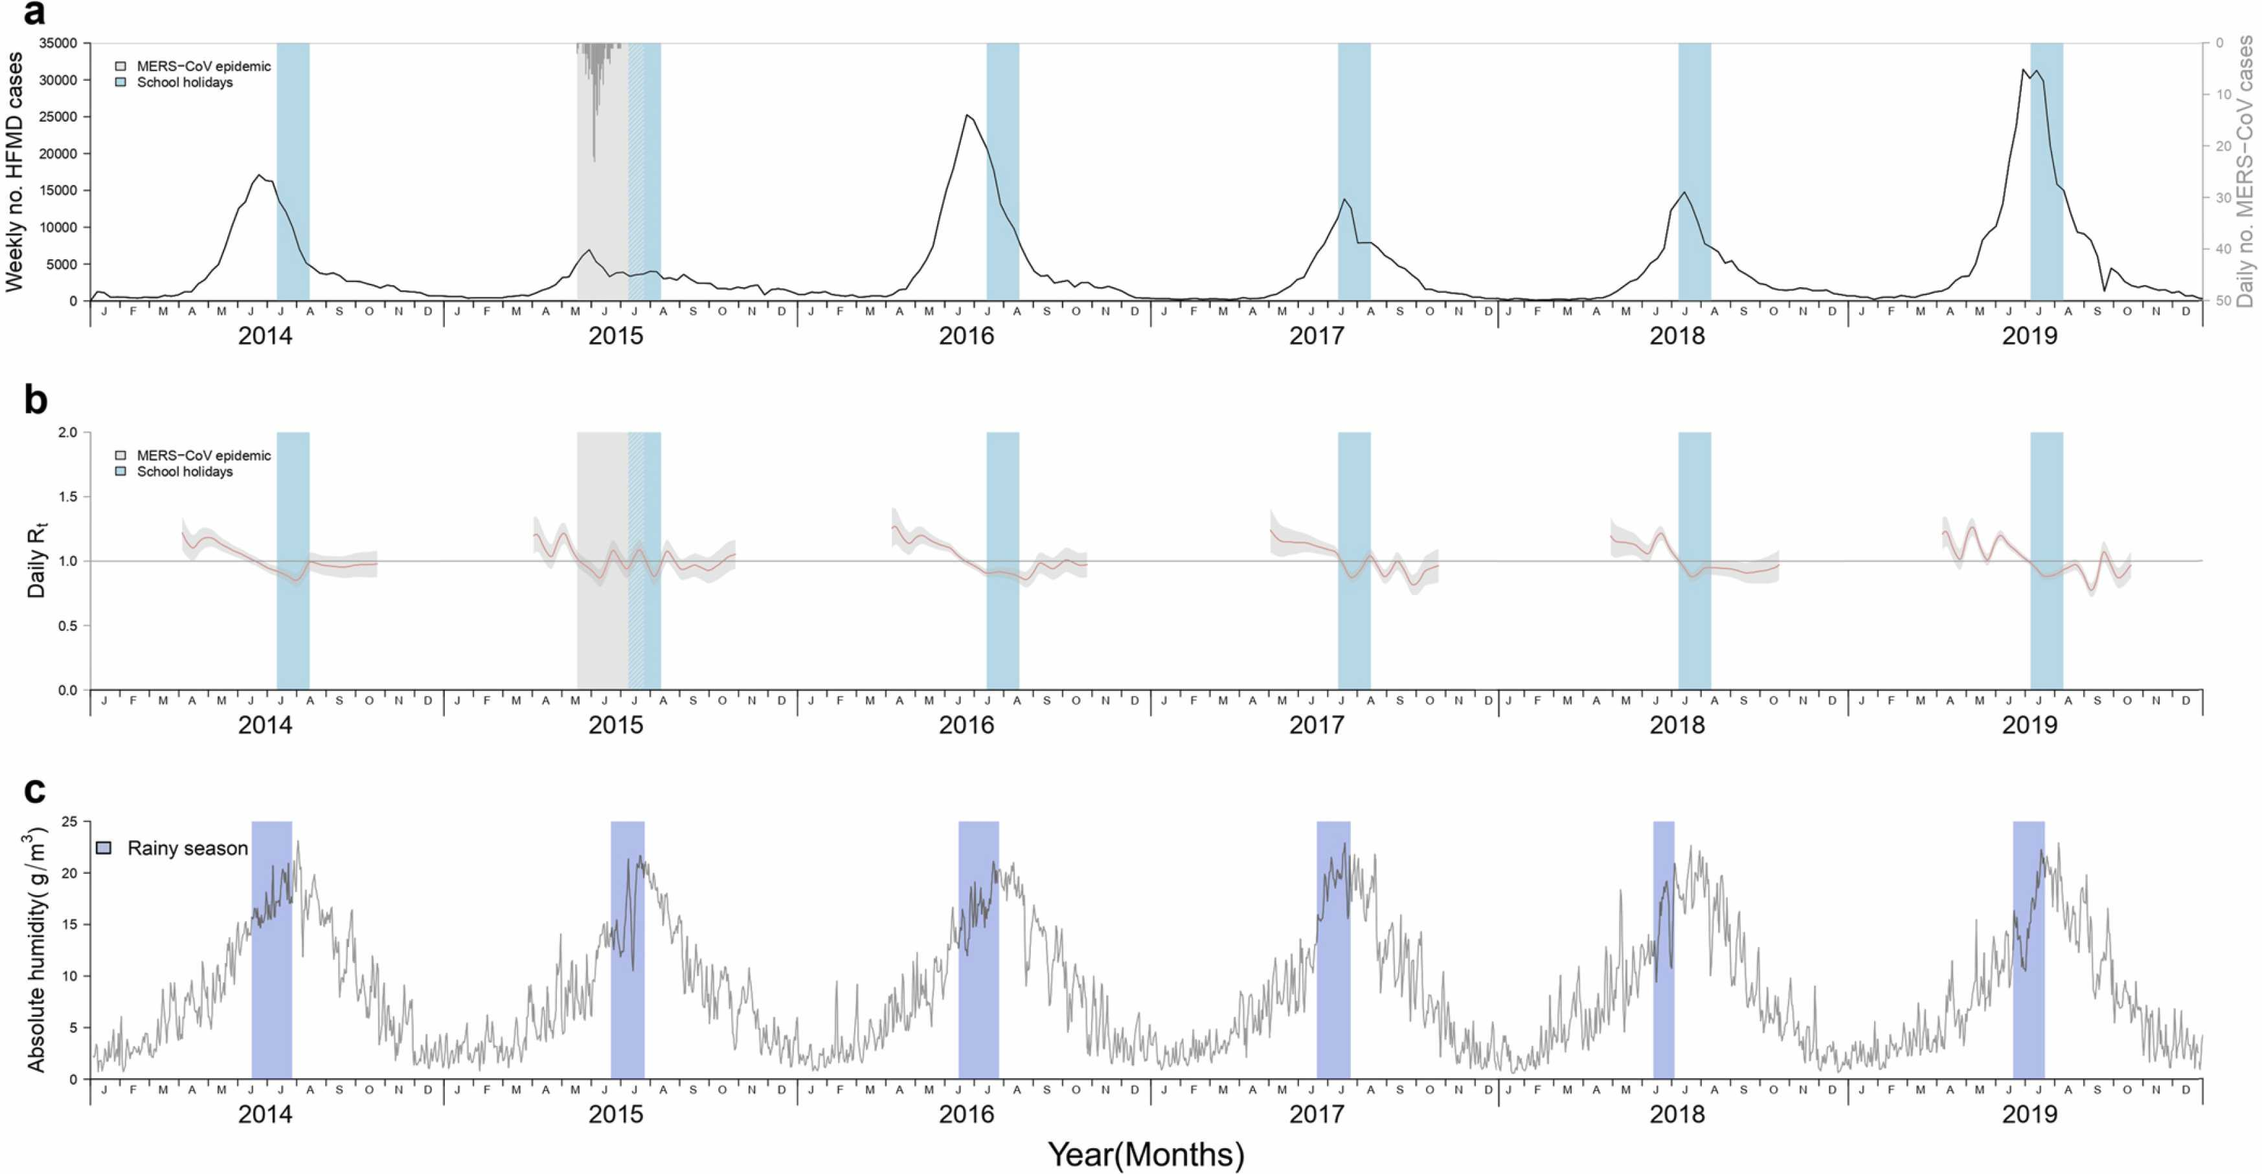
2. Periodicity: Repetition of behavior in a regular pattern
Repeated cycles of variation usually over a period of less than one year
Ryu et al., Journal of Infection and Public Health, 2023.

Slide 9
3) Seasonality: Periodic behavior with a known period (hourly, monthly, every 2 months...)
Health Topic | Seasonal Pattern | Explanation
Influenza (Flu) cases | Peaks in winter months (Nov–Feb in the Northern Hemisphere) | Cold, dry air facilitates virus survival and indoor crowding increases spread.
Allergy-related hospital visits | Peaks in spring and fall | Due to increased pollen (spring) and mold (fall).
Malaria cases | Peaks in the rainy season in tropical regions | Rain creates stagnant water, ideal for mosquito breeding.
Vitamin D deficiency | Higher in winter | Reduced sunlight exposure in winter months.
Ryu et al., Journal of Infection and Public Health, 2023.

Slide 10
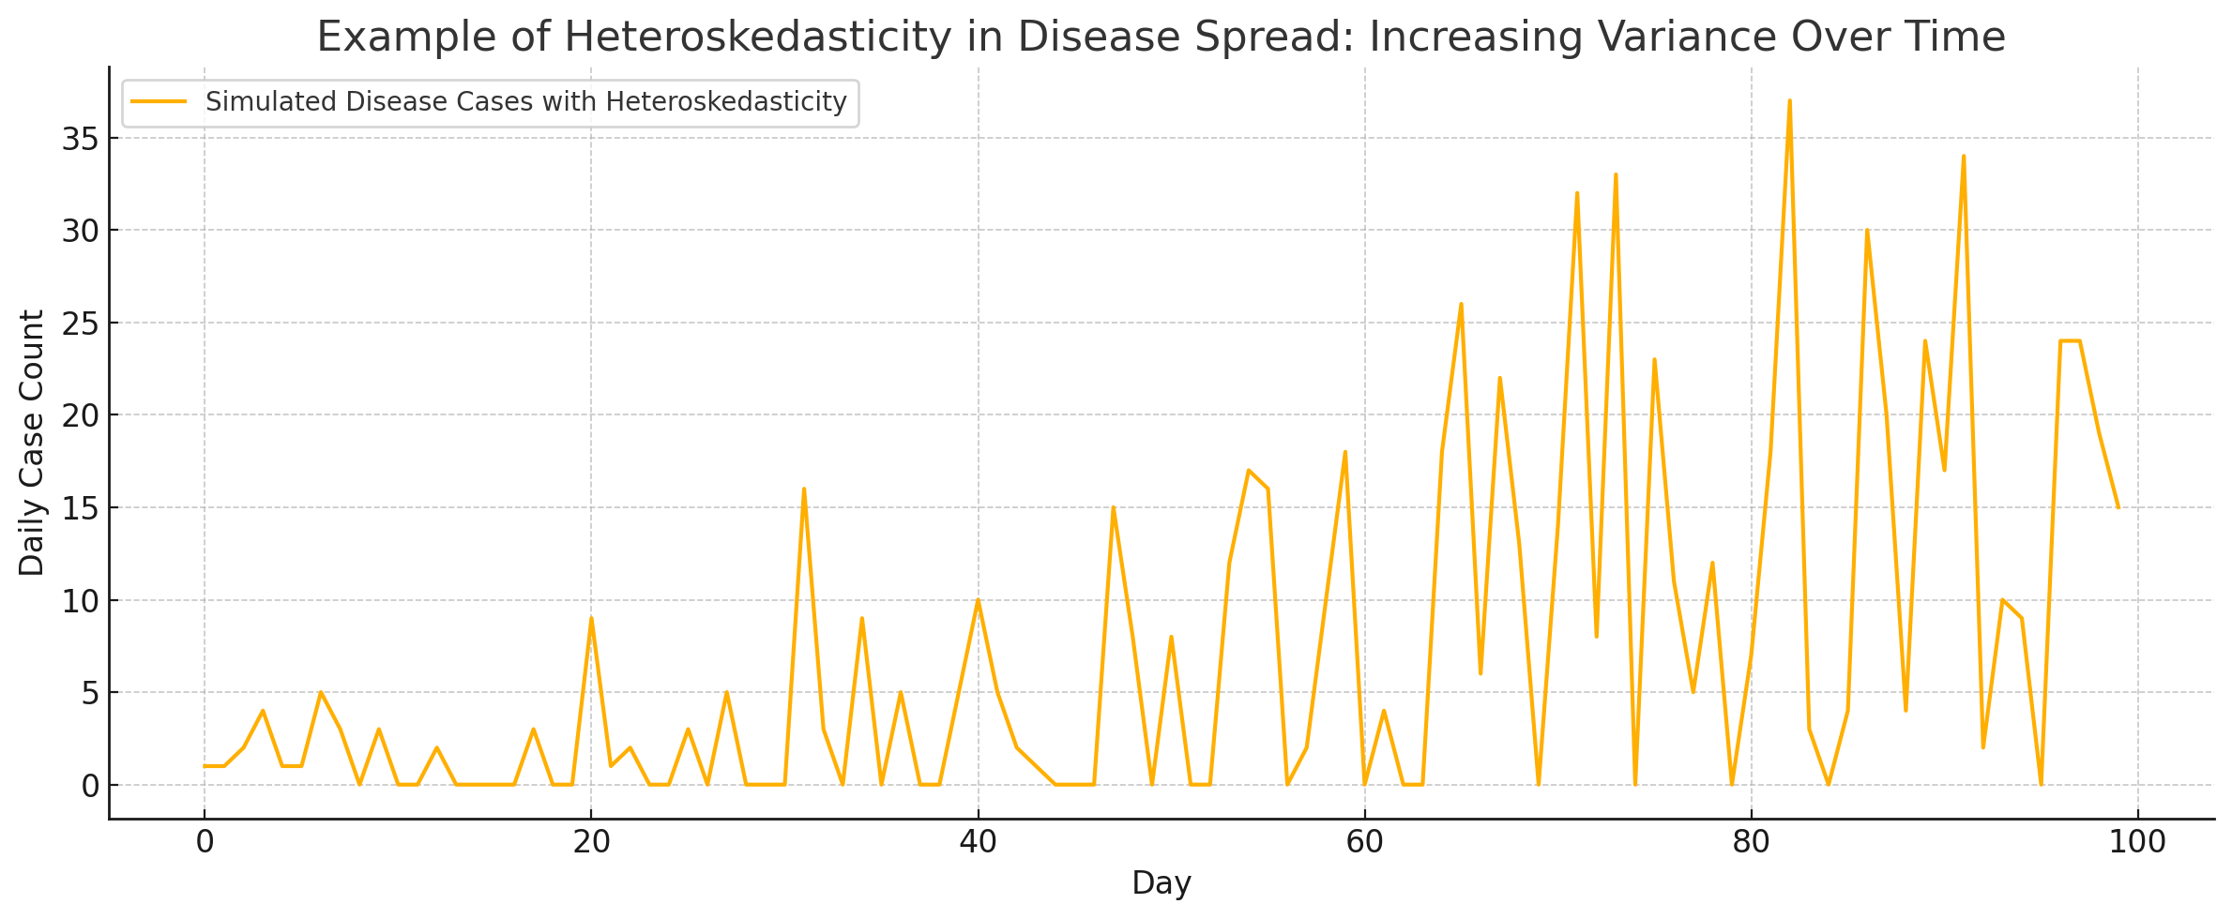
4. Heteroskedasticity: changing variance
Changing spread involving periods of low and high peaks across a period

Slide 11
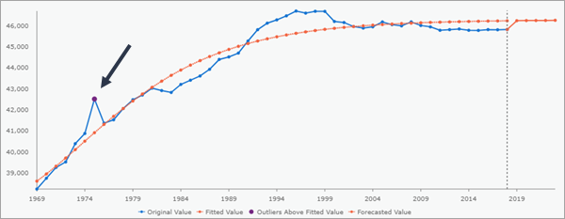
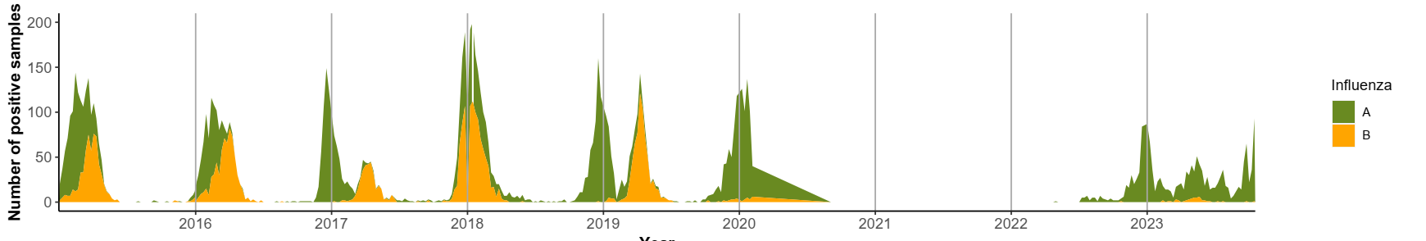
5. Missing data, outliers, and breaks
Time series analysis can be used to identify;
Data entry errors and data reporting delays
Extreme values that deviate significantly from the trend or seasonality.
Sudden changes in the underlying process (e.g., policy shifts, lockdowns).

Slide 12
Time series models
1-Classical models
Model | Description
AR (Autoregressive) | Predicts future values based on past values: Xt​=ϕ1​Xt−1​+ϵt​
MA (Moving Average) | A time series model where the current value of the series is expressed as a linear combination of past white noise error terms Xt​=μ+θ1​ϵt−1​+θ2​ϵt−2​+⋯+θq​ϵt−q​+ϵt​
ARMA | Combines AR and MA: good for stationary series. Xt​=ϕ1​Xt−1​+ϕ2​Xt−2​+⋯+ϕp​Xt−p​+θ1​ϵt−1​+θ2​ϵt−2​+⋯+θq​ϵt−q​+ϵt​
ARIMA Auto-Regressive Integrated Moving Average | Includes differencing to handle non-stationarity.
SARIMA | ARIMA with seasonal components.
Seasonal Decomposition (STL) | Breaks a series into seasonal, trend, and residual components.

Slide 13
Time series models
2- Heteroskedasticity models
Model | Description
ARCH (Autoregressive Conditional Heteroskedasticity) | Models time-varying variance based on past squared errors.
GARCH (Generalized ARCH) | Extends ARCH by modeling variance as a function of both past errors and past variances.

Slide 14

Practice session using R!

Slide 15
The Data
Download the mock data sets from the link below: https://github.com/ACHANGWA/Time-series-analysis-lecture
Datasets to be used
mockdata1 - Daily number of SARS-CoV-2 cases 2020 – 2022
mockdata2 - Weekly reported cases of some respiratory viruses
mockdata3 - Monthly reported cases of Chlamydia

Slide 16
Open R Studio (Installed from: https://posit.co/download/rstudio-desktop/ )
Load the following R libraries;
library(readr)
library(dplyr)
library(psych)
library(forecast)
# install.packages(“package") if not yet installed

Slide 17
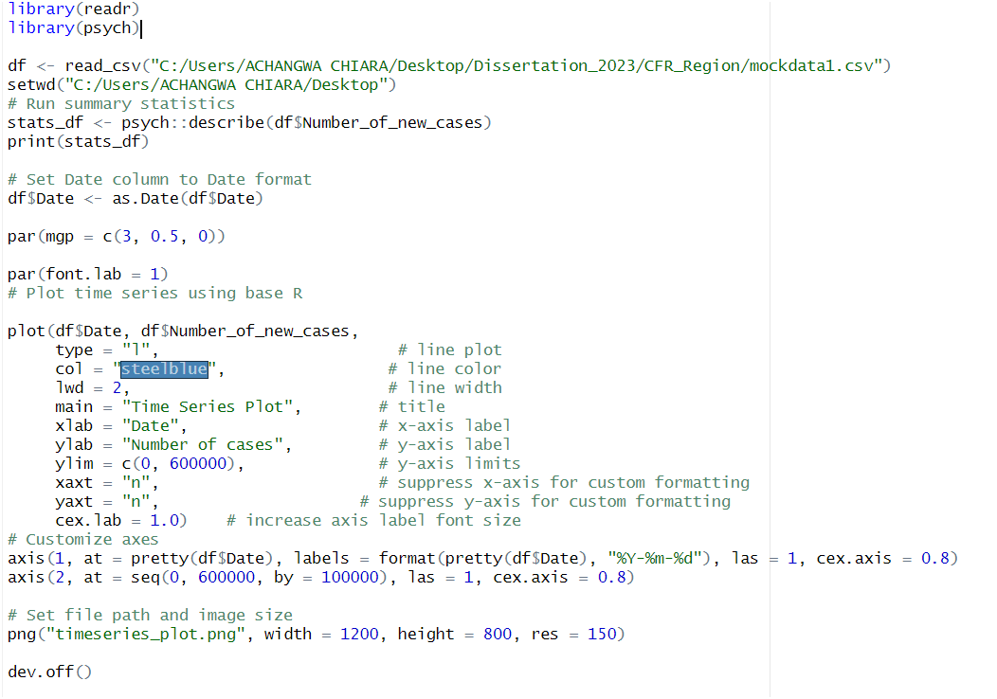
Scenario 1: Time series analysis using daily data

Slide 18
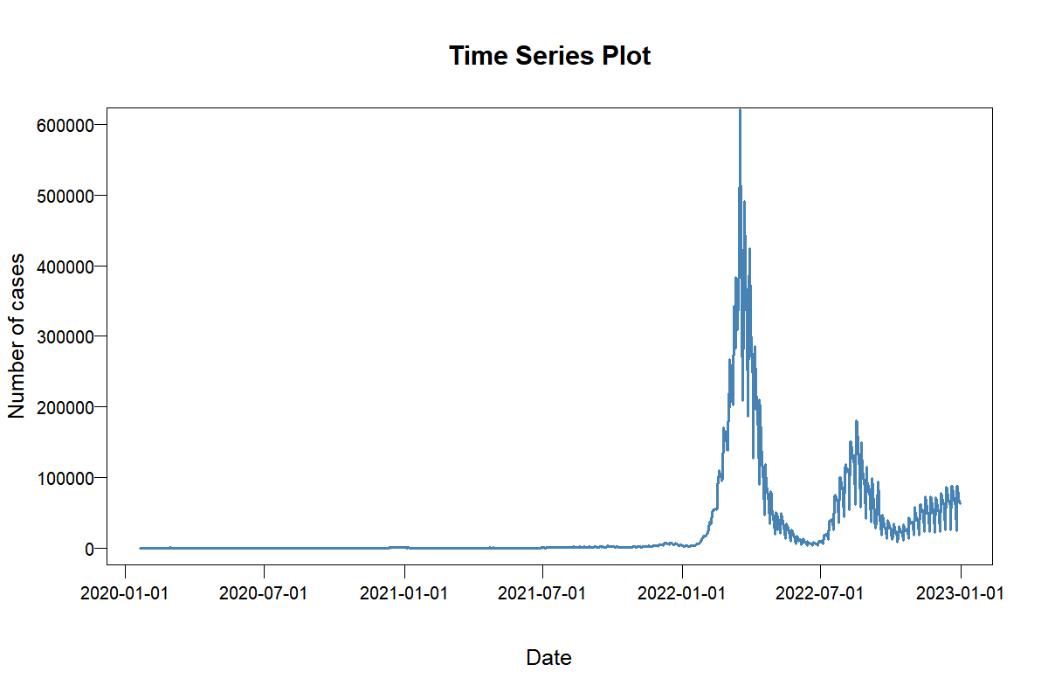
Output

Slide 19
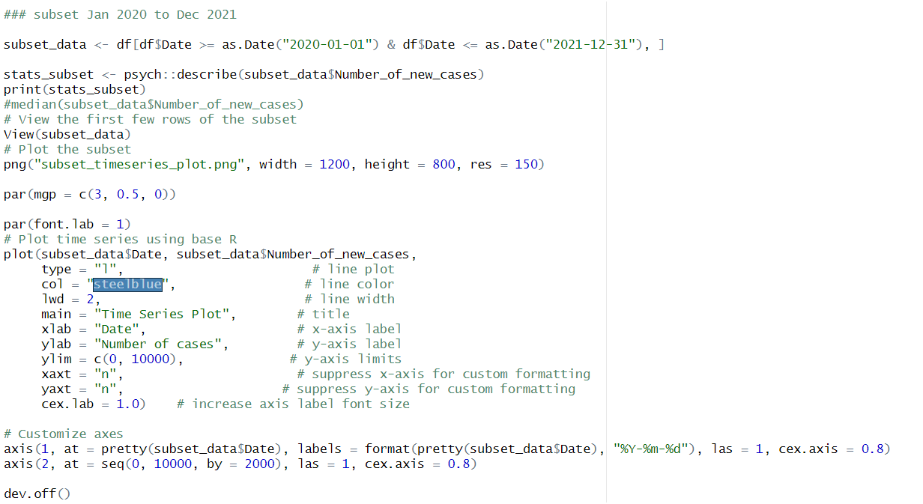
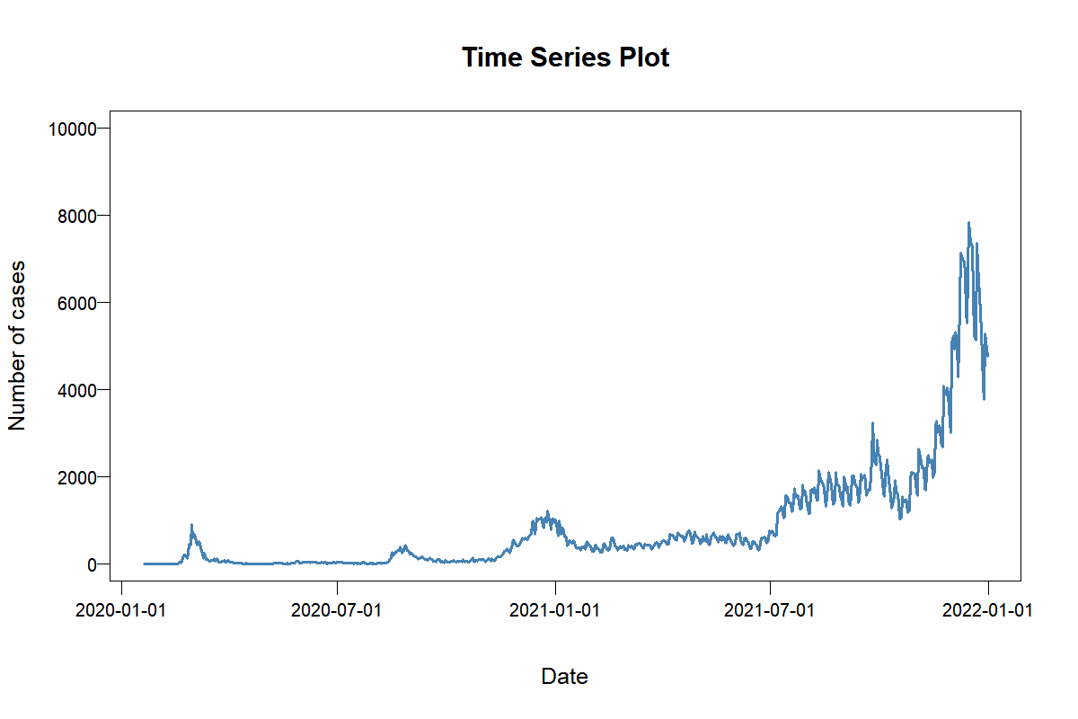

Slide 20
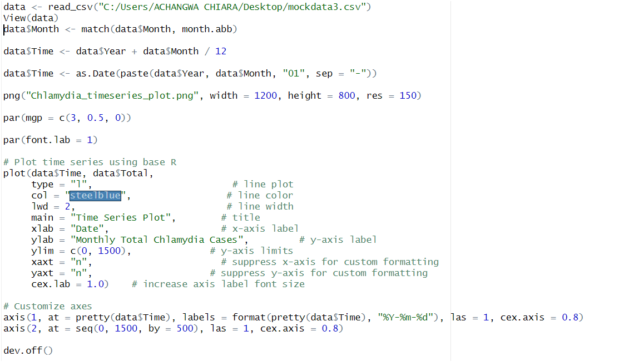
Scenario 2: Time series analysis using monthly data

Slide 21
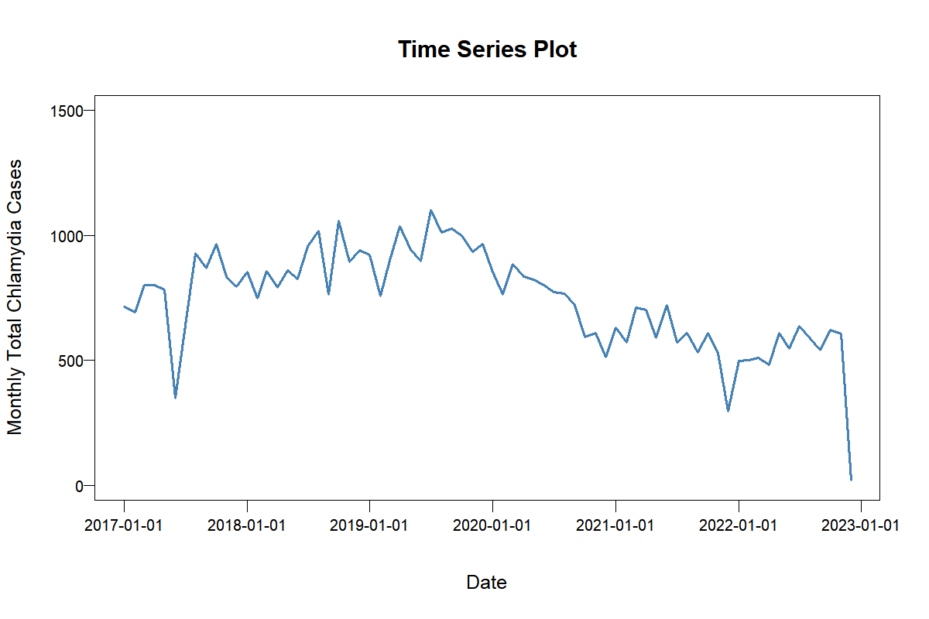
Output

Slide 22
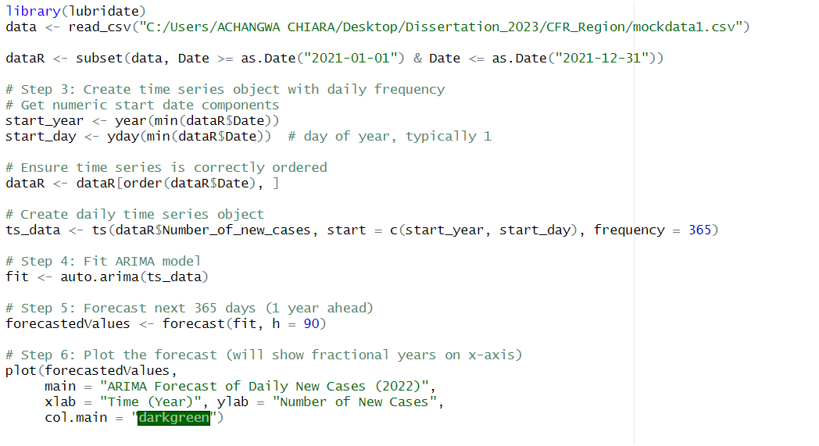
Performing an ARIMA model

Slide 23
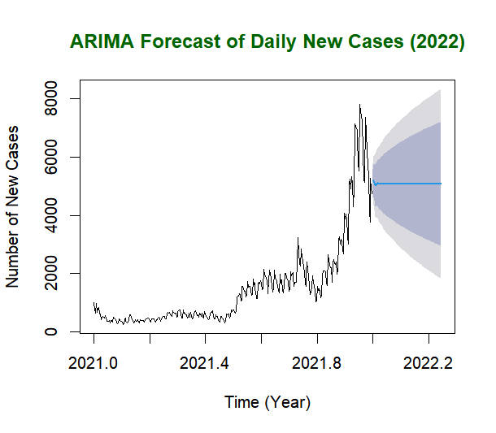
Output

Slide 24

Thank you!!!
http://onehealth.or.kr/

